Slide 1

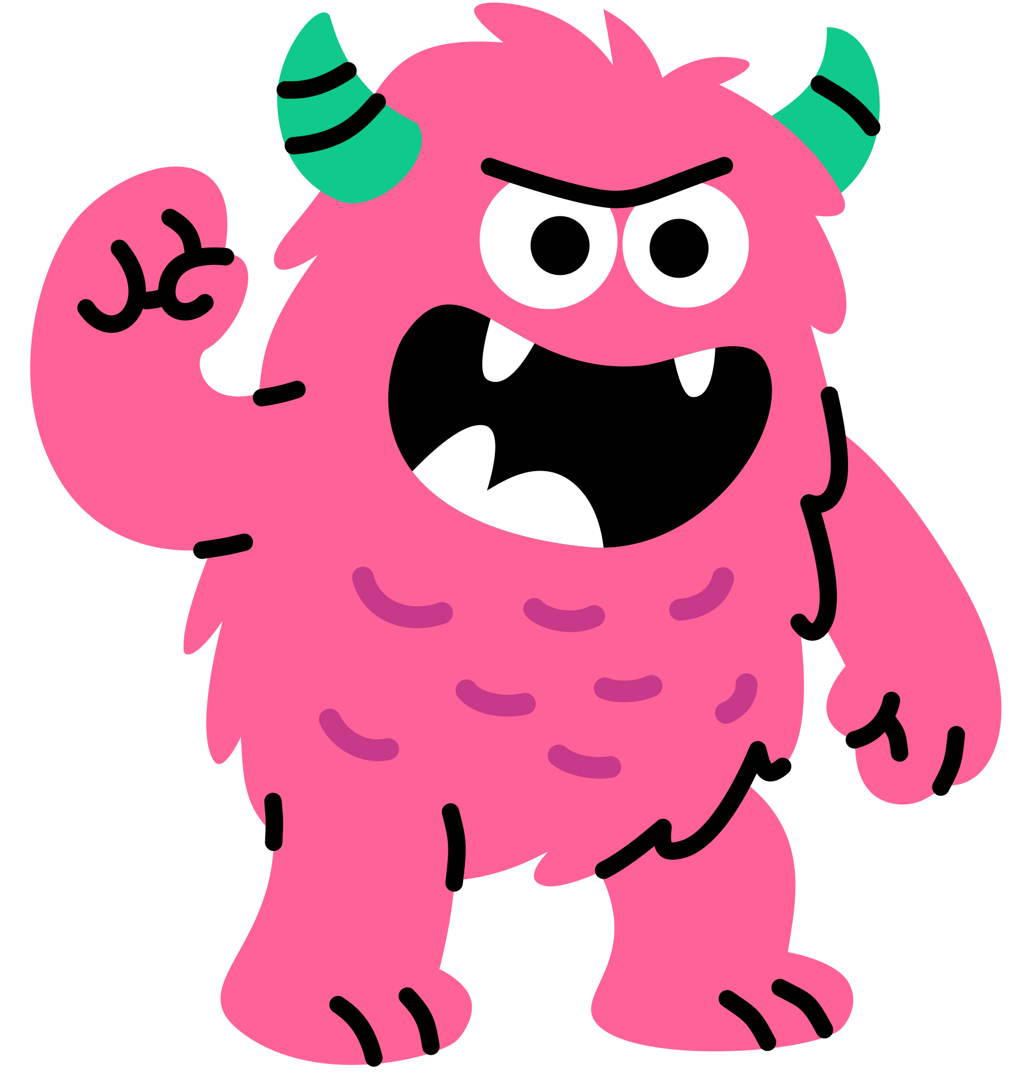

G2-5
Kindness Monsters
Writing Project
S1 • S2 • S3

Slide 2

Mini-Lesson
While you watch…
  Dream up your monster
  Pick a setting (like school)
  Plan one act of kindness
Click For Video
S1 • S2 • S3

Slide 3


Your Kindness Monster
Turn to the person sitting next to you and tell them
  Your monster's name and special features
  One kind act they will perform
You get 2 minutes
S1 • S2 • S3

Slide 4
G2-5
Session 1
Brainstorm and Plan your story
S1

Slide 5
Learning Objectives
I can think of 3+ ideas and pick my best one.
I can sort my ideas in the boxes to make a plan.
I can listen to a partner and add one helpful suggestion.
S1

Slide 6
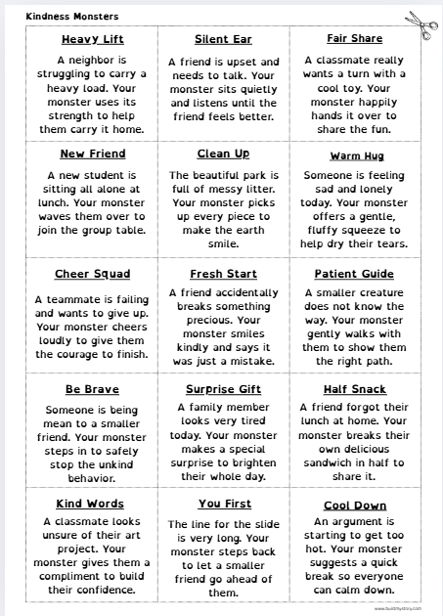
Choose a prompt
  Your teacher will hand out the Prompt Sheet
  Pick one idea or write your own
  Cut it out and glue on your Brainstorm sheet (or write your choice at the top)
  Keep it simple and clear
S1

Slide 7

Make your idea bold and exciting
• Explore different places to show kindness
• Choose one main act of kindness
• Let your monster’s special features help them succeed
• If your story grows or changes, that’s part of the journey!

Slide 8
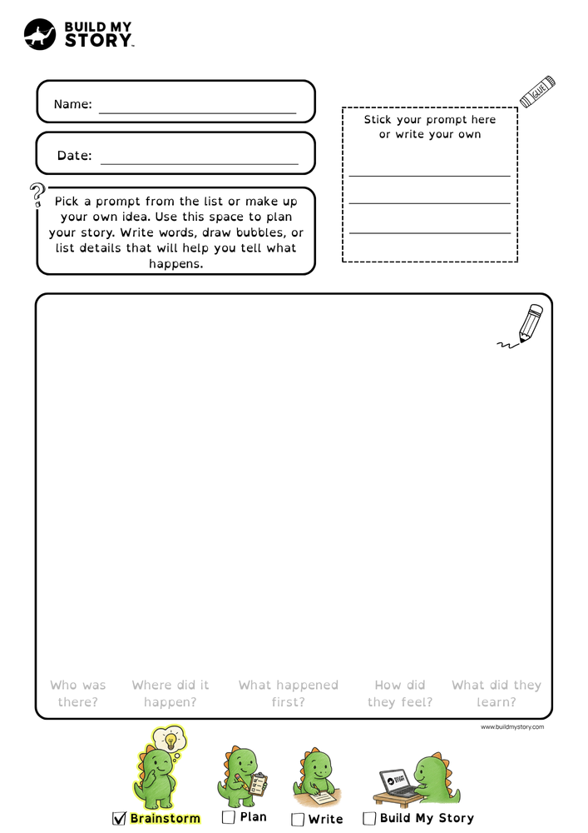
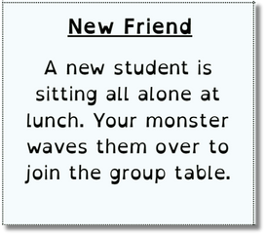
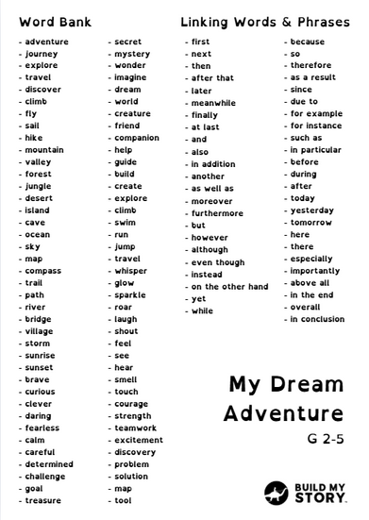
Brainstorm your ideas
You get 10 minutes
Use the word bank to help
  Use the Brainstorm sheet
  Words or quick sketches
  Use your senses
  Fill the page
S1

Slide 9



Turn to the person next to you and ask...
• Who is in your story?
• Where does it happen?
• When does it happen?
You get 2 minutes

Slide 10
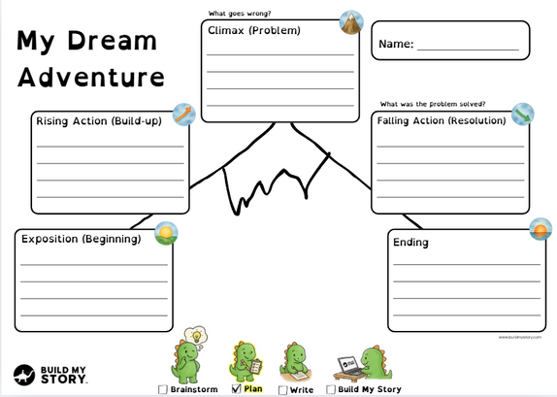





Story Mountain overview
You get 15 minutes
Climax:
Show the BIG problem or exciting event.
Rising Action:
Show what your characters are doing and build up to the problem.
Falling Action:
Show how the characters try to solve the problem and what happens next.
Exposition (Beginning):
Introduce your setting and characters
Ending:
Show how everything finishes and how the characters feel.
S1

Slide 11


Turn to the person next to you and ask...
• What is the BIG moment?
• How do things finish and how do they feel at the end?
You get 2 minutes

Slide 12

Build your main character
You get 10 minutes
  Name
  What type of monster are they?
  What do they look like?
  Are they wearing any clothes?
  One memorable detail
S1

Slide 13

Wrap Up & Next Time
Before you go – check
  Do you have a main character?
  Is there a beginning, middle and end?
  Is your name on every sheet?
Please hand in your amazing work so far!
Next time – your writing choices
  Summary → Help me write (bring 4–6 sentences)
  Full draft → Type it myself (aim for ≤ 200 words)
S1

Slide 14

Learning Objectives
I can think of 3+ ideas and pick my best one.
I can sort my ideas in the boxes to make a plan.
I can listen to a partner and add one helpful suggestion.
S1

Slide 15
G2-5
Session 2
Write Your Story
S1

Slide 16
Learning Objectives
I can turn my plan into a draft.
I can use words like first / next / because to connect ideas.
I can add a detail so my writing is clearer.
S1

Slide 17
The 5-part story frame
1
4
Falling Action:
Show how the character tries to solve the problem and what happens next.
Exposition (Beginning):
Introduce your setting and characters
2
Rising Action:
Show what your character is doing and build up to the problem.
5
Ending:
Show how everything finishes and how the character feels.
3
Climax:
Show the BIG problem or exciting event.
S2

Slide 18


Choose your path
Either path is great — pick the one that helps you do your best
PATH A
PATH B
OR
Story Summary
(4–6 sentences)
Full Draft
(About 500 words)
Only as much as you can do
S2

Slide 19
Path A: Story Summary — 4–6 sentences
1) Who + where (Exposition)
2) Want + problem (Rising Action)
3) BIG moment (Climax)
4) What they try / what happens next (Falling Action)
5) How it ends + feeling (Ending)
S2

Slide 20
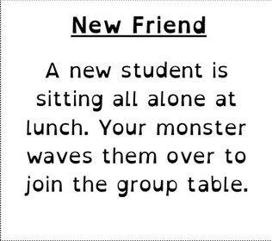
Example Story Summary 1
1) Blue stood alone on the loud playground during morning recess.
2) He saw a new student on the bench with no one to play with.
3) Blue walked over and waved them toward the big group table.
4) They shared a fun game of tag and ran all around the swings.
5) Blue had a brand new friend and felt very proud of himself.
S2

Slide 21
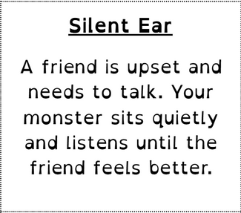
Example Story Summary 2
1) My monster, Pip, was sitting on the grass in the quiet school garden.
2) He saw a friend crying and wanted to make them feel better.
3) Pip sat down and used his giant ears to listen to every word.
4) As he listened, his friend started to feel calm and safe.
5) They gave Pip a high-five and he felt happy to be a helper.
S2

Slide 22
Path B: Full Draft - About 500 words
• Around 500 words total - do as much or as little as you can!
• Short sentences
• Use this order:
Beginning → Build-up → BIG moment → Fixing it → Ending + feeling
S2

Slide 23
Write on the worksheet page by page. Think about the Story Mountain and follow the icons.
Draft guide
• Beginning — 2–3 lines
• Build-up — 3–5 lines
• BIG moment — 2–3 lines
• Fixing it — 3–4 lines
• Ending + feeling — 2–3 lines
S2

Slide 24
Show, don’t tell
Tell → The monster was very kind.
Show → He shared his last snack and gave a big smile.
Tell → The classroom was very messy.
Show → Broken crayons and crumpled papers lay everywhere.
Swap one “tell” for a “show.”
S2

Slide 25
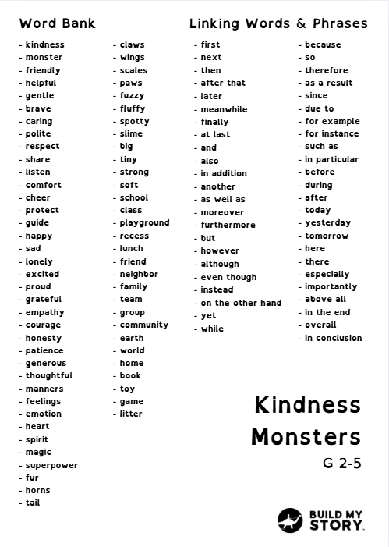

Write Time!
You get 20 minutes
Summary path: finish 5 sentences.
Draft path: aim for 300-500 words.
Tip: Use 2–3 linking words.
Use the word bank to help
S2

Slide 26
Swap your worksheet with the person next to you
3 quick checks (circle or say Yes/No)
1) Does it follow the 5 parts? Beginning → Build-up → BIG moment → Fixing it → Ending
2) Are there 2–3 linking words? (first, next, then, after that, because, so, finally…)
3) Is there one “show, don’t tell” sentence?
Fix one thing, then put your name on your work.
You get 2 minutes

Slide 27
Learning Objectives
I can turn my plan into a draft.
I can use words like first / next / because to connect ideas.
I can add a detail so my writing is clearer.
S1

Slide 28
G2-5
Session 3
Build Your Story
S3

Slide 29
Learning Objectives
I can revise my draft story to make it clearer
I can fix capitals, punctuation, and spelling.
I can type my story and give it a great title.
I can publish a book!
I can make an AI picture
S1

Slide 30



Sign in
1
2
3
  Open Build My Story
  Tap Kid to sign in
  Log in using username
Your teacher will help with usernames or Clever or Google Classroom
S3

Slide 31

Set up your book
1
2
  Type your main character’s name
  Choose your reading level (ask if unsure)
3
  Pick your picture style
4
  Click Continue
S3

Slide 32


Choose how to write
Path A
Path B
Help me write — paste your summary
Type it myself — type your story
S3

Slide 33
Help me write — paste your summary
1
  Paste your 4–6 sentence summary
4
  Choose Language
2
  Choose Story Type
5
3
  Choose Writing Style
  Click Continue
S3

Slide 34
Type it myself
  Type into the 11 pages
1
Remember:
Beginning → Build-up → BIG moment → Fixing it → Ending
Use 2–3 linking words
2
  Click Continue
S3

Slide 35



Build your character
  OR
  Upload a drawing
  OR
  Click ‘Continue without uploading character’
  A picture of a character
S3

Slide 36

Build your character
Choose Character Type:
  Human, Animal or Fictional
1
  Age or character type if its an animal or fictional
2
3
  Type character appearance.
4
  Click ‘Generate New Character’
What does the character look like?
S3

Slide 37


Build your character
  Click to view all of the characters you have made
S3

Slide 38

Edit Your Book Until You Are Happy!
  Edit Your Title
  Edit Author Name
  Scroll and Read your amazing story!
S3

Slide 39


How to edit text
  Click ‘Edit Text’
  Type, Edit and ‘Update Text’
S3

Slide 40

How to edit Images
  Click ‘Edit Image’
  Type in your Image Prompt
What is an image prompt? →
S3

Slide 41
What is a good image prompt?
  What’s a prompt?
It’s the sentence that tells the app what to draw on this page.
  Your main character stays the same—you change the action, place, and details.
  The 4 Magic Parts (A-P-O-M)
  Action – what is the character doing?
  Place – where is it happening?
  Objects – 1–2 things to include (props).
  Mood/Time – how it feels (cozy, windy) or when (evening, rainy).
S3

Slide 42
Quick Example Image Prompts
  Good Prompt
“The fluffy monster shares a bright red toy in a sunny playroom; colorful blocks are on the floor.”
  Not Good Prompt
“The monster is in the school.”
  Why is this not a good prompt? Put your hand up
Remember The 4 Magic Parts (A-P-O-M)
Action + Place + Objects + Mood/Time
S3

Slide 43


Why is this a bad prompt?
  Not Good Prompt
“The monster is in the school.”
Action – No Action
Place – “School”
Objects – No Objects
Mood/Time – No Mood/Time
The bad prompt has not passed the 4 magic parts!
S3

Slide 44

Why is this a good prompt?
  Good Prompt
“The fluffy monster shares a bright red toy in a sunny playroom; colorful blocks are on the floor.”
Action – “Shares a toy...”
Place – “Sunny playroom”
Objects – “Toy,” “Colorful blocks”
Mood/Time – “Sunny,” “Bright”
The good prompt has passed the 4 magic parts!
And that’s how to use AI!
S3

Slide 45



You can even add more characters!
1
2
3
  Click ‘Select New Character’
  Create or choose a new character
  Edit Image Prompt
Remember to change your image prompt with your new character!
S3

Slide 46



Proof Read when you’re finished!
  Click on the
S3

Slide 47
Learning Objectives
I can revise my draft story to make it clearer
I can fix capitals, punctuation, and spelling.
I can type my story and give it a great title.
I can publish a book!
I can make an AI picture
S1

Slide 48
G2-5
What is AI?
Optional Add On
S3

Slide 49



The first question is...
What is A.I?
S3

Slide 50
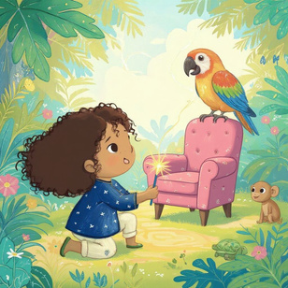





What is A.I?
AI = Artificial Intelligence.
  • It means computers learn patterns from lots of examples.
  • Then they use those patterns to help us: recognize voices, suggest words, translate, draw pictures from words, and chat.
That’s how your character was made!
S3

Slide 51
  In Build My Story, AI can:
– grow your summary into a story (Help me write)
  – make pictures from your prompt (Create new image)
  Remember!
AI is NOT a person. It has no feelings and can make mistakes.
  YOU are the author — check, edit, and choose what to keep.
  Story Summary → Big Story
Be smart & kind online:
• Don’t share private info (full name, address, passwords).
• Ask an adult if something doesn’t look right.
  Image Prompt →
S3

