Slide 1
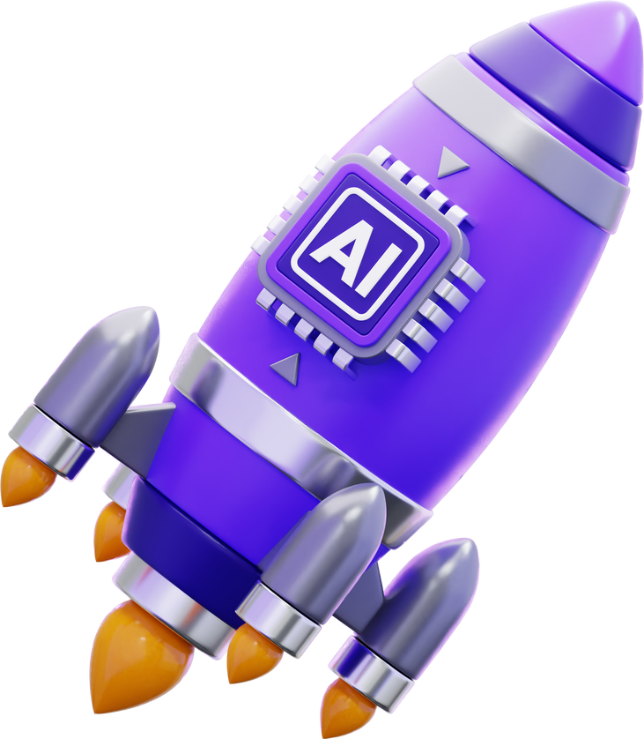


The first question is...
What is A.I?

Slide 2
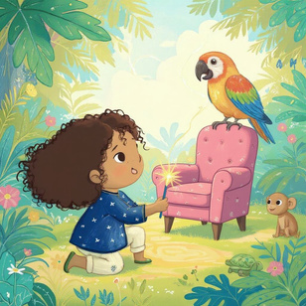






What is A.I?
AI = Artificial Intelligence.
  • It means computers learn patterns from lots of examples.
  • Then they use those patterns to help us: recognize voices, suggest words, translate, draw pictures from words, and chat.
That’s how your character was made!
S3

Slide 3
  In Build My Story, AI can:
– grow your summary into a story (Help me write)
  – make pictures from your prompt (Create new image)
  Remember!
AI is NOT a person. It has no feelings and can make mistakes.
  YOU are the author — check, edit, and choose what to keep.
  Story Summary → Big Story
Be smart & kind online:
• Don’t share private info (full name, address, passwords).
• Ask an adult if something doesn’t look right.
  Image Prompt →
S3

Slide 4
What is a good image prompt?
  What’s a prompt?
It’s the sentence that tells the app what to draw on this page.
  Your main character stays the same—you change the action, place, and details.
  The 4 Magic Parts (A-P-O-M)
  Action – what is the character doing?
  Place – where is it happening?
  Objects – 1–2 things to include (props).
  Mood/Time – how it feels (cozy, windy) or when (evening, rainy).
S3

Slide 5
Quick Example Image Prompts
  Good Prompt
“The fluffy monster shares a bright red toy in a sunny playroom; colorful blocks are on the floor.”
  Not Good Prompt
“The monster is in the school.”
  Why is this not a good prompt? Put your hand up
Remember The 4 Magic Parts (A-P-O-M)
Action + Place + Objects + Mood/Time
S3

Slide 6


Why is this a bad prompt?
  Not Good Prompt
“The monster is in the school.”
Action – No Action
Place – “School”
Objects – No Objects
Mood/Time – No Mood/Time
The bad prompt has not passed the 4 magic parts!
S3

Slide 7

Why is this a good prompt?
  Good Prompt
“The fluffy monster shares a bright red toy in a sunny playroom; colorful blocks are on the floor.”
Action – “Shares a toy...”
Place – “Sunny playroom”
Objects – “Toy,” “Colorful blocks”
Mood/Time – “Sunny,” “Bright”
The good prompt has passed the 4 magic parts!
And that’s how to use AI!
S3

