Slide 1

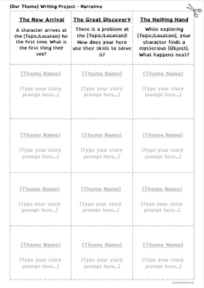
Before the Writing Begins: Teacher Prep Guide
To give your students the best experience as authors, follow these simple steps to "bolt on" your class theme to this project.
Step 1: Define Your "North Star" Theme
Decide on the topic your students will write about. This could be anything you are currently teaching!
  Examples: Life on a Farm, The Solar System, Exploring the Arctic, or Our Community Heroes.
Step 2: Prepare Your Prompts
Choose the option that works best for your classroom flow today:
Option A (The Custom Print-Out):
Open the Prompt Sheet template. Type specific prompts based on your theme into the boxes. Print the sheet and hand it out; students will cut out their favorite and glue it to their Brainstorm Sheet.
Option B (The Whiteboard Method):
Write 3-6 story prompts on your whiteboard. Give students the Brainstorm Sheet and have them manually write their favorite prompt into the box that says "Write your own prompt here."
Step 3: Print and Organize
Once your prompts are ready, print enough copies so every student can choose one.
Teacher Pro-Tip: Looking for inspiration on how long a prompt should be? Check out the Kindness Monsters Example Sheet in your resource folder to see how simple, 2-sentence prompts can spark huge imagination!
Class writing Theme:
(Write your theme here so you can refer back to it during the lesson!)

Slide 2

[Our Theme] Writing Project - Narrative
The New Arrival
The Great Discovery
The Helping Hand
A character arrives at the [Topic/Location] for the first time. What is the first thing they see?
There is a problem at the [Topic/Location]! How does your hero use their skills to solve it?
While exploring [Topic/Location], your character finds a mysterious [Object]. What happens next?
[Theme Name]
[Theme Name]
[Theme Name]
[Type your story prompt here...]
[Type your story prompt here...]
[Type your story prompt here...]
[Theme Name]
[Theme Name]
[Theme Name]
[Type your story prompt here...]
[Type your story prompt here...]
[Type your story prompt here...]
[Theme Name]
[Theme Name]
[Theme Name]
[Type your story prompt here...]
[Type your story prompt here...]
[Type your story prompt here...]
[Theme Name]
[Theme Name]
[Theme Name]
[Type your story prompt here...]
[Type your story prompt here...]
[Type your story prompt here...]
www.buildmystory.com

